Slide 1


Titolo presentazione sottotitolo
Numerical Methods – Project 3
Group 1
Manfred Nesti
Luca Caivano
Bruno Ursino
Alessandro Pegurri
Valeria Pajola
Chiara Vitale
Andrea Della Libera
Milano, XX mese 20XX

Slide 2


Short range force formula derivation
For the charge distribution we used a linearly decreasing charge, with zero at r_{cut} as follows:
From this we evaluated the force applied from particle j to particle i due to the charge distribution as follows:
where F(r) is a primitive of r ρ(r)
$$ρ\left(r\right)=H\left(1−\frac{r}{r_{c}}\right)$$
$$F_{ji}=\frac{q′_{i}q′_{j}}{ε_{0}′}\frac{∂}{∂x_{i}}\left(\frac{4π}{\left\|x_{j}−x_{i}\right\|}\int_{0}^{\left\|x_{j}−x_{i}\right\|}{F}\left(r\right)dr\right)$$

Slide 3
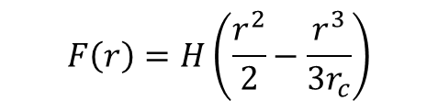
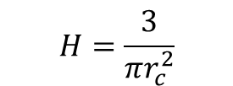
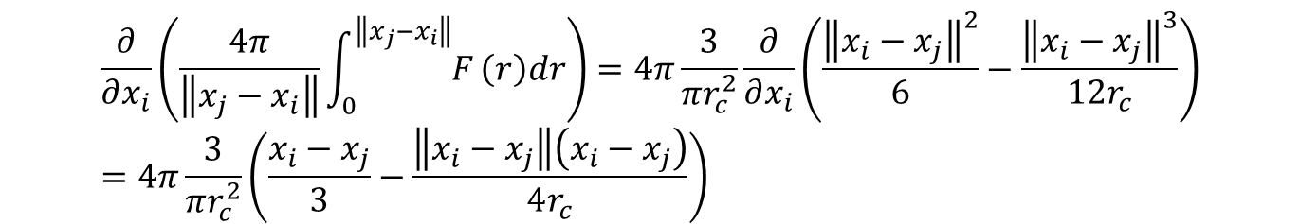
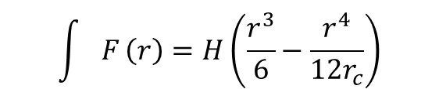
Short range force formula derivation
Since we needed to normalize the charge distribution ρ so that its 3D integral was 1, we got the following value for H:
Moreover, we evaluated F and a primitive of F as follows:
This led to:
$$H=\frac{3}{πr_{c}^{2}}$$
$$F\left(r\right)=H\left(\frac{r^{2}}{2}−\frac{r^{3}}{3r_{c}}\right)$$
$$\int{F}\left(r\right)=H\left(\frac{r^{3}}{6}−\frac{r^{4}}{12r_{c}}\right)$$
$$\frac{∂}{∂x_{i}}\left(\frac{4π}{\left\|x_{j}−x_{i}\right\|}\int_{0}^{\left\|x_{j}−x_{i}\right\|}{F}\left(r\right)dr\right)=4π\frac{3}{πr_{c}^{2}}\frac{∂}{∂x_{i}}\left(\frac{{\left\|x_{i}−x_{j}\right\|}^{2}}{6}−\frac{{\left\|x_{i}−x_{j}\right\|}^{3}}{12r_{c}}\right)=4π\frac{3}{πr_{c}^{2}}\left(\frac{x_{i}−x_{j}}{3}−\frac{\left\|x_{i}−x_{j}\right\|\left(x_{i}−x_{j}\right)}{4r_{c}}\right)$$

Slide 4
Force formula
Thus, the final force for the charge distribution resulted:
And the total short range force between particle j and particle i:
$$F_{ji}=\frac{q′_{i}q′_{j}}{ε_{0}′}4π\frac{3}{πr_{c}^{2}}\left(\frac{1}{3}−\frac{\left\|x_{i}−x_{j}\right\|}{4r_{c}}\right)\left(x_{i}−x_{j}\right)=\frac{q′_{i}q′_{j}}{ε_{0}′r_{c}^{2}}\left(4−3\frac{\left\|x_{i}−x_{j}\right\|}{r_{c}}\right)\left(x_{i}−x_{j}\right)$$
$$F_{ji}=−24ε_{ij}′\left[{\left(\frac{σ′_{ij}}{r_{ij}}\right)}^{6}−2{\left(\frac{σ′_{ij}}{r_{ij}}\right)}^{12}\right]\frac{{\vec{r}}_{ij}}{r_{ij}^{2}}+\frac{q′_{i}q′_{j}}{ε_{0}′}\left(\frac{1}{r_{ij}^{3}}+\frac{4}{r_{c}^{2}}−3\frac{\left\|x_{i}−x_{j}\right\|}{r_{c}^{3}}\right){\vec{r}}_{ij}$$

Slide 5
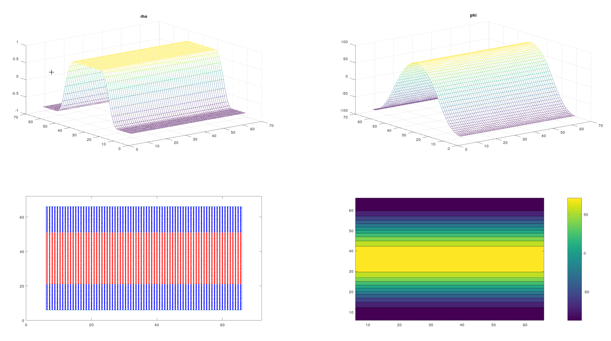
Charge distribution and Poisson solution t = 0 s

Slide 6

Solution (N = 5700)

Slide 7
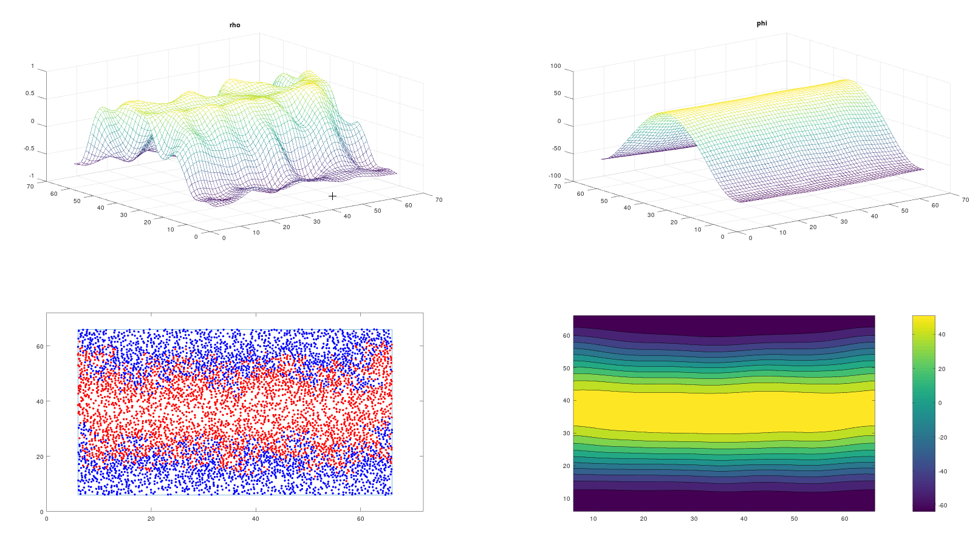
Charge distribution and Poisson solution t = 0.24 s

Slide 8
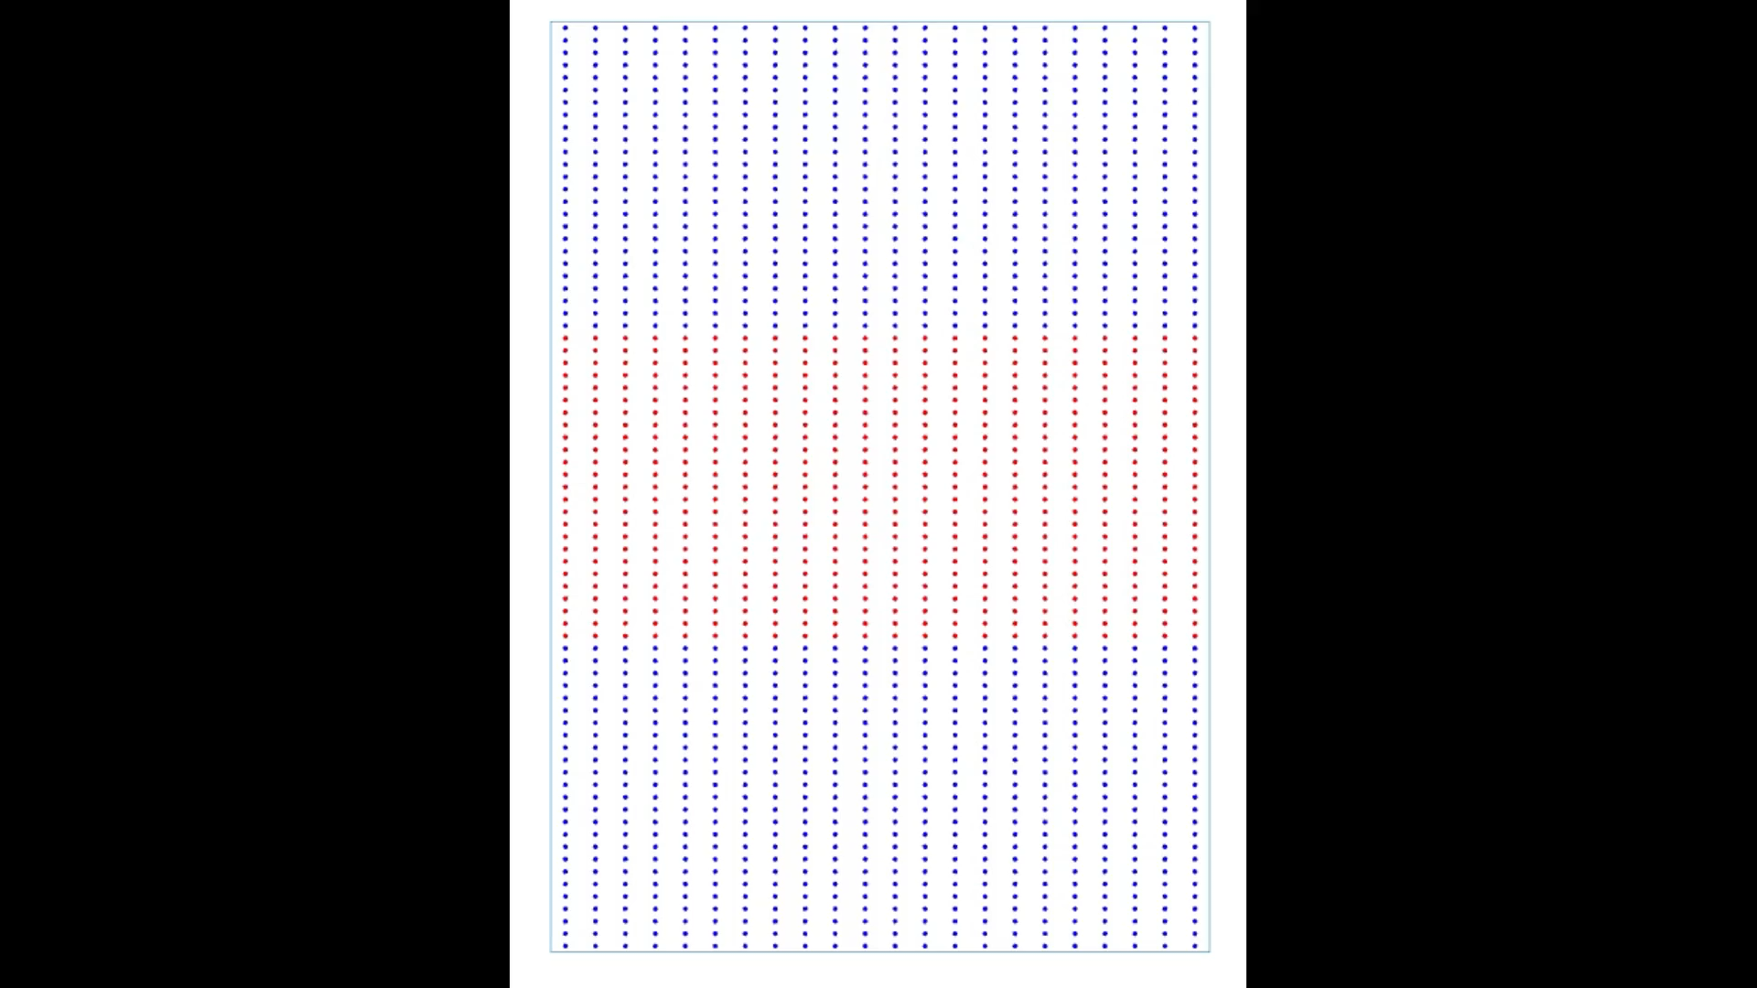
Solution (N = 1650 and wrong initial charge distribution)

Slide 9
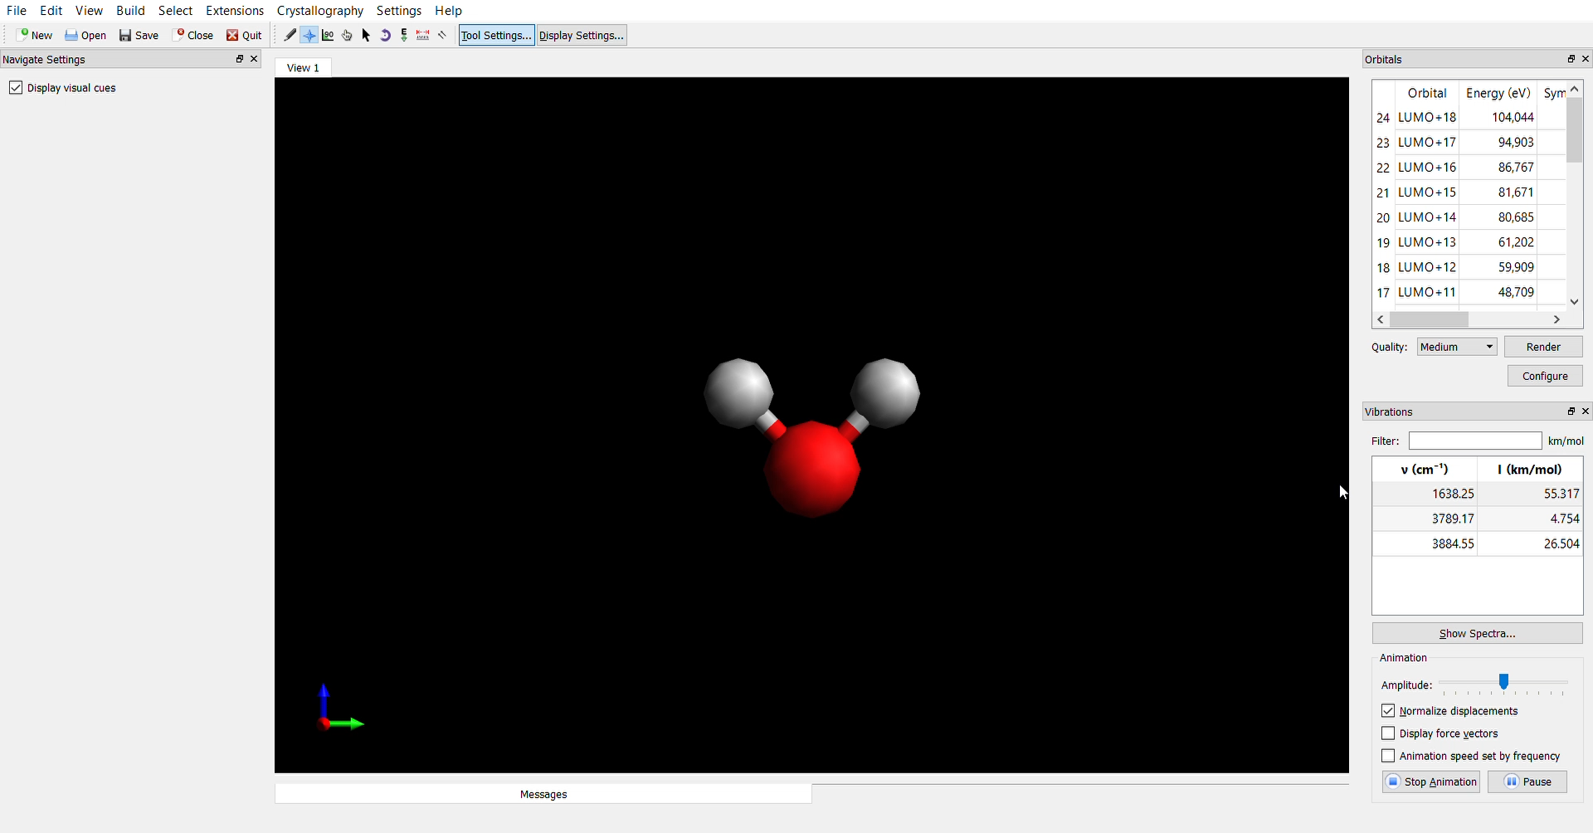
Thank you
Manfred Nesti
Luca Caivano
Bruno Ursino
Alessandro Pegurri
Valeria Pajola
Chiara Vitale
Andrea Della Libera

